Slide 1
Open Geospatial Data
Natural Resources Canada- Federal Geospatial Platform
Nicolas Gariépy, Eng
Janice Sharpe, Senior Director, FGP

Slide 2
Open Geospatial Data in Canada: Perspectives from the Federal Geospatial Platform

Slide 3
A foundation for data sharing exists…
Some trends to consider:
Rapid acceleration of data creation
Technology transformation
Rising expectation of free, easy data access
Increased initiatives and policies that promote data sharing and access
International standards for data sharing and exchange
Concern over individual privacy and personal and national security

Slide 4
A foundation for data sharing exists…
A few key building blocks:
A Data Strategy Roadmap for the Federal Public Service
Open Government Partnership
Federal Open Government Directives
Open Government Portal
Provincial / Territorial Open Government Directives and Portals
The Federal Geomatics Accord and the Canadian Council on Geomatics
Hundreds of websites
Many science collaborations and data sharing initiatives

Slide 5
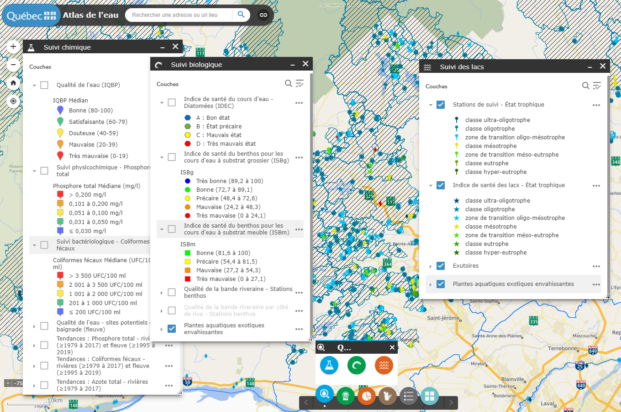
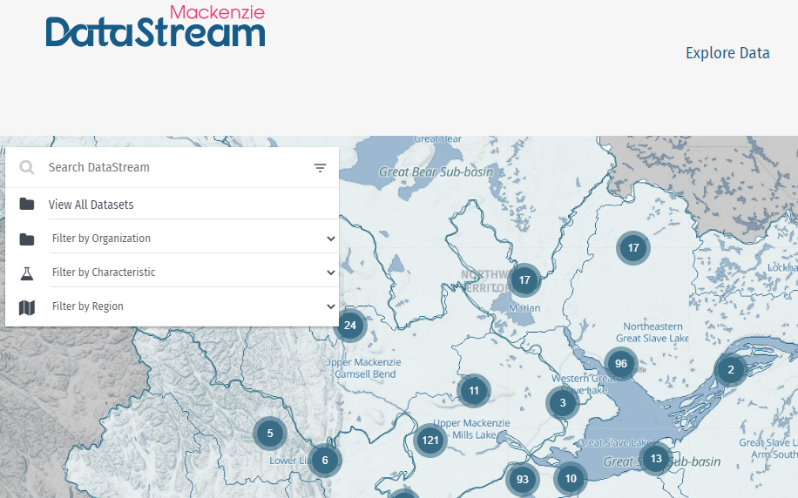
There are hundreds of resources out there
Non-Government Organizations
Provincial / Territorial Atlases

Slide 6
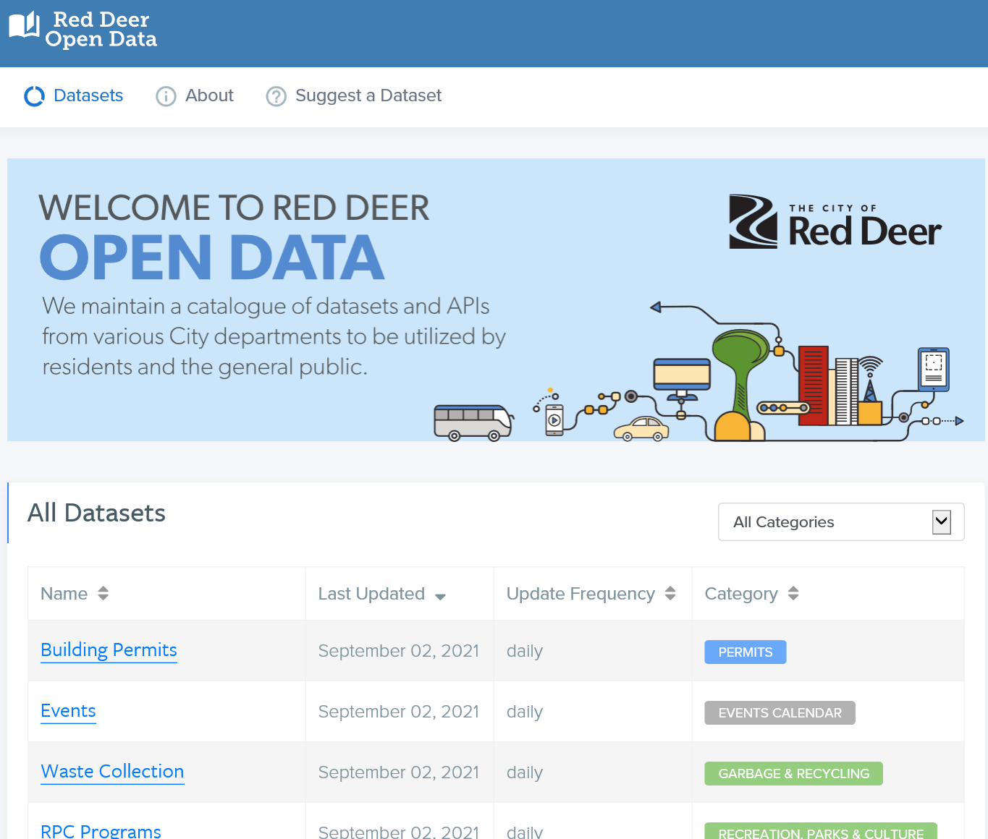
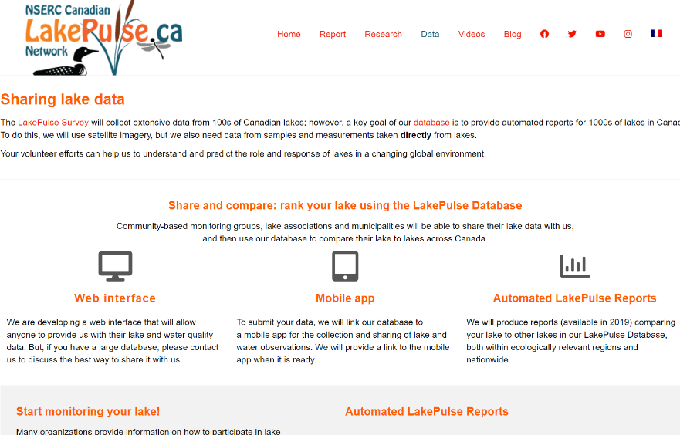
There are hundreds of resources out there
Municipal/City
Crowd-Sourced

Slide 7
Our Open Government portal is growing…
A Snapshot on “Water” Keyword Search
Open Maps
(660 Geospatial Water records)
Data and Information from:
- Federal Departments and organizations, including Crown Corporations (71)
Provinces of Alberta, Ontario and Quebec
Geospatial Data from:
- Federal Departments and Agencies (22)
Provinces of British-Columbia, Alberta, Ontario, Quebec, New-Brunswick and Yukon
7

Slide 8
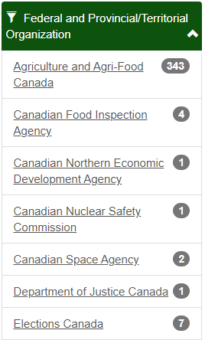
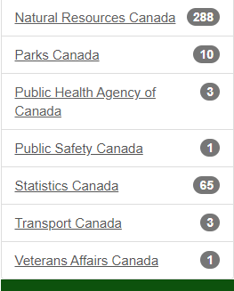
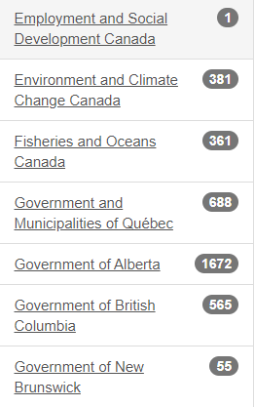
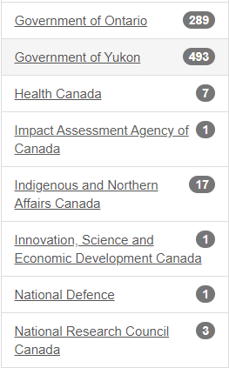
Open maps – Access for all Canadians
5,200+ interoperable data layers available from 22 federal departments and 5 provinces/territory

Slide 9
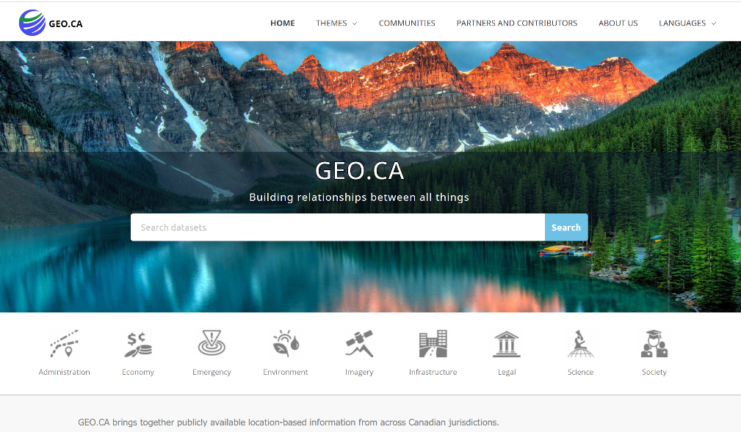

Setting the course for better access and discovery
Canada’s new GEO.CA will be the beginning of some big steps forward for open geospatial data in Canada. A neutral platform where users from all levels of government, industry, academia and more, can discover the geospatial information that is important to them.
Supported by a high quality content management system that meets our needs.
GEO.CA is currently in development.

Slide 10
Data sharing journey is often complex
Some challenges to consider
Data is distributed across organizations and jurisdictions
Some is licensed
Data and products produced are not always current
Some is not harmonized across jurisdictions
Some is tucked away inside organizations
“Getting it right” takes investment and collaboration, and time

Slide 11
Data sharing journey is often complex
But challenges lead to opportunities…
We have many building blocks in place
We have the means to “just get the data out there”
Standards exist, we need to leverage them
We practice keeping data closest to the source, adopting federated system
We can drive an Open Government culture
We can apply FAIR principles for scientific data management: Findability, Accessibility, Interoperability, and Reuseability of data/digital assets

Slide 12
Project Highlight: Federating open geospatial data

Slide 13
Project: Origins
In 2017, the Canadian Council on Geomatics agreed to include P/T geospatial metadata and services in the Federal Geospatial Platform.
In 2018, environmental scanning explored:
P/T portal status,
Inventory of datasets & services
Technology stacks used
Readiness for discovery through FGP
Legal/licensing terms
In 2019, B.C. data was piloted successfully
Since then, integration has been ongoing
All P/T available open geospatial data will be included by March 2023
Notes:
(Canadian Council on Geomatics Annual General Meeting)

Slide 14
Project: Federated Search Parameters
The data stays where it is. Only metadata is integrated into our systems
Integration of open license data sets compatible with Canada’s Open Government Licence only
Distributed with the original license
Automated process, weekly updates
Metadata automatically translated via artificial intelligence to support official languages

Slide 15
Project: Architecture
Open Science & Data Platform
JSON
geoDCAT
Metadata
Provincial / Territorial/ Municipal
Extract, transform, & load
Federal Geospatial Platform
Geospatial
JSON
CKAN-extCA
XML
PNAH ISO 19115:2003
Collection:
Open Maps
Open
Government (Federal)
JSON
CKAN-extCA
Collection:
Federated data
Non- Geospatial

Slide 16
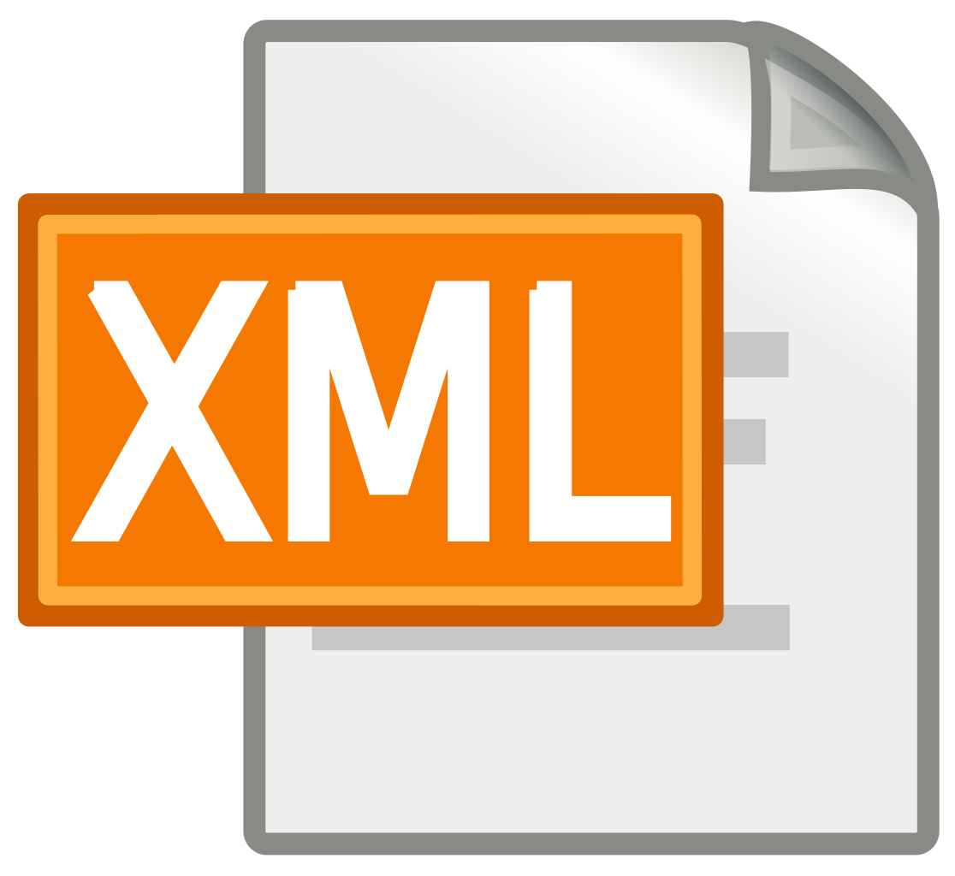





Project: Process
Working data model
PNAH-
ISO19115:2003
Provincial/ Territorial/ Municipal
License filtering
Geo content
Insert/ Update
Geo vs non-geo
Meta
Format
Type
ID
Unilingual model
CKAN-extCA
Non-geo content
Insert/Update
One portal/
one metadata model
Various technologies (CKAN, DKAN, Socrata…)
Geo
PNAH
Non Geo
CKAN-extCA
Delta
+
MAJ
-
Ø
Execution report
Delete
Configuration file to update
Translation
en→fr / fr→en

Slide 17
Project: Lessons Learned
Some issues to overcome
Each province has its own data model
Being compliant with standard helps interoperability
Usage vs compliance
Semi-bilingual metadata in a unilingual model
Non plain text metadata distribution
Spatial extent using toponyms

Slide 18
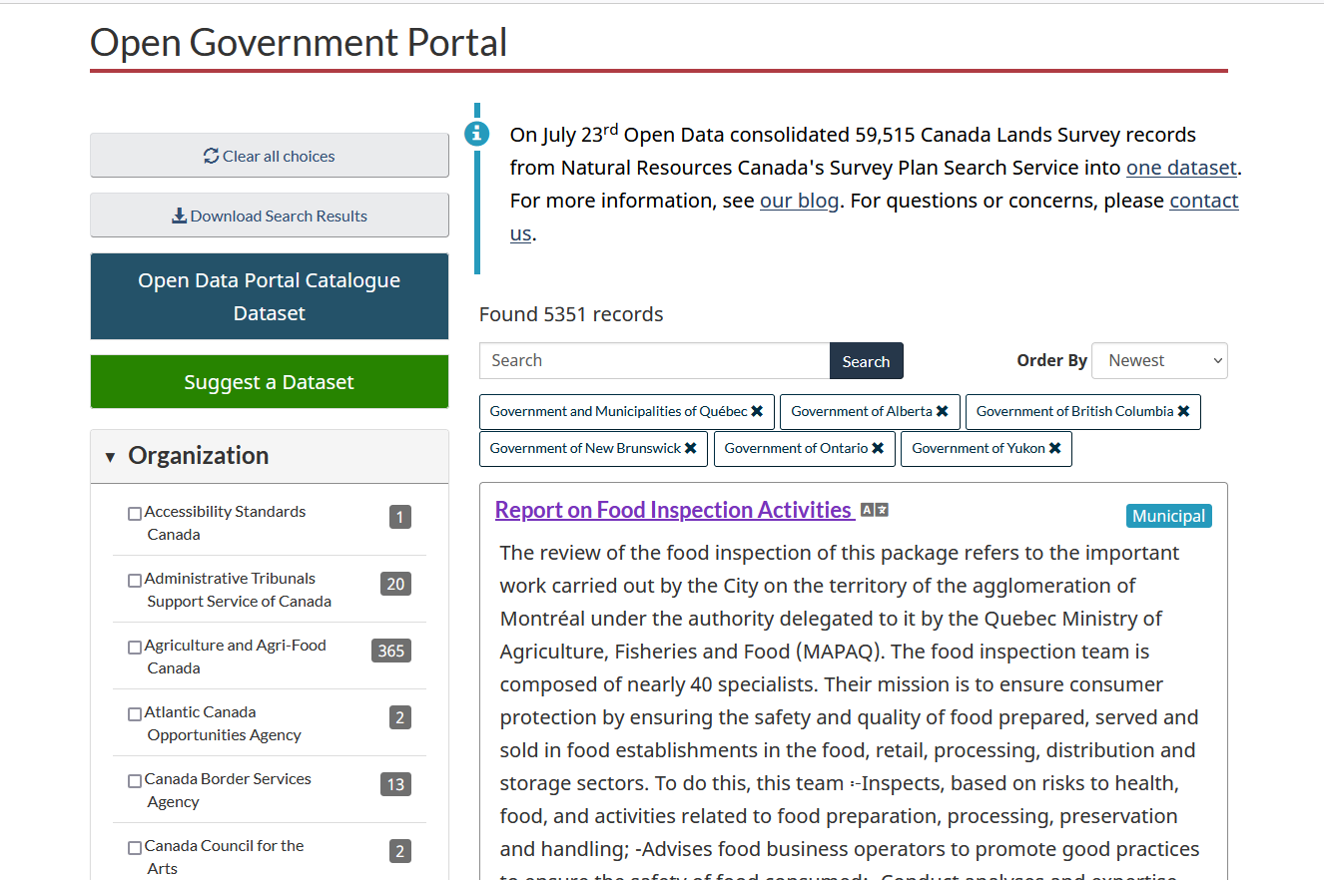
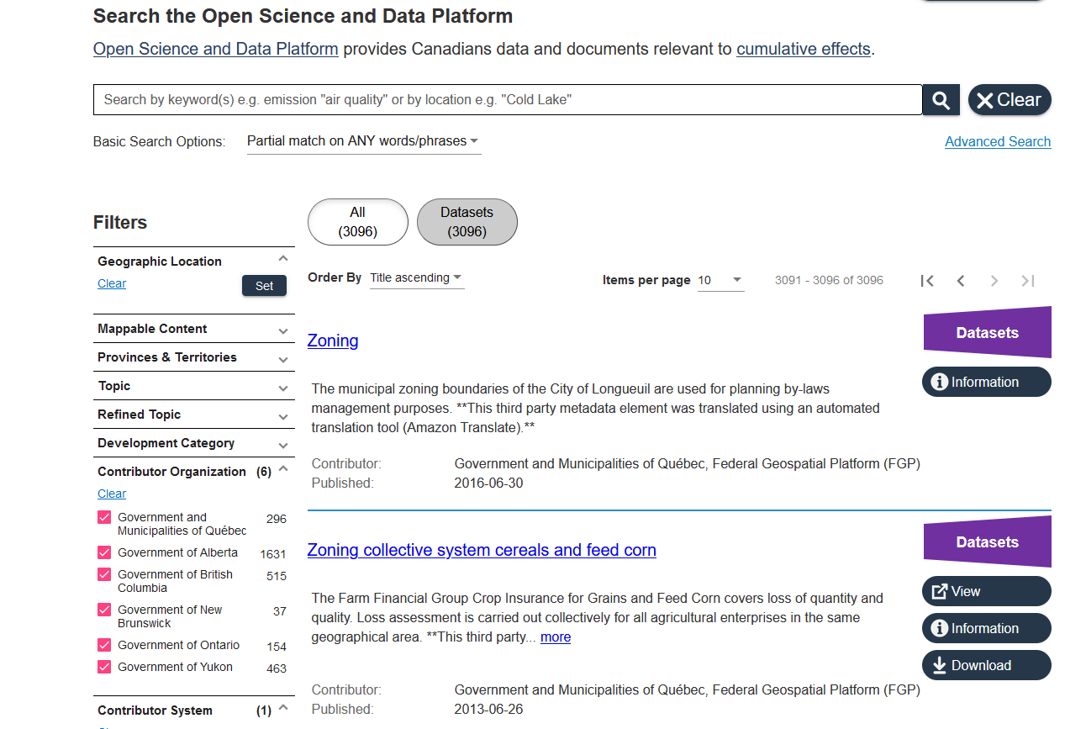
Demo
The Open Science and Data Platform: Geospatial data to describe the cumulative effects of resource development
https://osdp-psdo.canada.ca/en/osdp
Canada’s Open government portal
https://open.canada.ca/en/open-data

Slide 19

Annex: Plans for full P/T inclusion
Partners | Portal | Geo integration | Non geo integration
British Columbia | https://data.gov.bc.ca | (500 +) | 2022-23
Alberta | https://open.alberta.ca/opendata | (1600 +) | 2022-23
Ontario | https://data.ontario.ca | (280 +) | (440 +)
Québec and municipalities | https://www.donneesquebec.ca | (680 +) | (540 + )
Yukon | https://gnb.socrata.com/ | (490 + ) | 2021-22
New-Brunswick | https://geohub.saskatchewan.ca | (50 + ) | 2021-22
Nova-Scotia | https://data.princeedwardisland.ca | 2021-22 | 2021-22
Prince Edward Island | https://opendata.gov.nl.ca | 2021-22 | 2021-22
Saskatchewan | https://geoportal.gov.mb.ca | 2021-22 | 2021-22
Manitoba | https://data.novascotia.ca | 2021-22 | 2021-22
Newfoundland and Labrador | https://open.yukon.ca/data | 2021-22 | 2021-22
Northwest Territories | https://www.geomatics.gov.nt.ca | 2022-23 | 2022-23
Nunavut | ? | ? | ?

Slide 20
Thank you, and connect with us!
Janice Sharpe, Senior Director
janice.sharpe@nrcan-rncan.gc.ca
Nicolas Gariépy, Eng
nicolas.gariepy@nrcan-rncan.gc.ca

Slide 21
© Sa Majesté la Reine du chef du Canada, représentée par le ministre des Ressources naturelles, 2021

